Slide 1



Maximum Synergy Under One Roof

Slide 2


How to Improve Renewable Energy Storage with MQTT, Modbus, and InfluxDB Cloud Dedicated
Ricardo Kissinger | München, 26.09.2023

Slide 3
Agenda – Introduction to Company
01
Introduction of ju:niz Energy GmbH
Who we are and what we do
02
Showcase of Generation 1.0 BESS
References from our first Generation BESS
03
Showcase of Generation 1.5 BESS
A few examples from our current “SMAREG“ projects

Slide 4


Introduction of ju:niz Energy GmbH
01

Slide 5
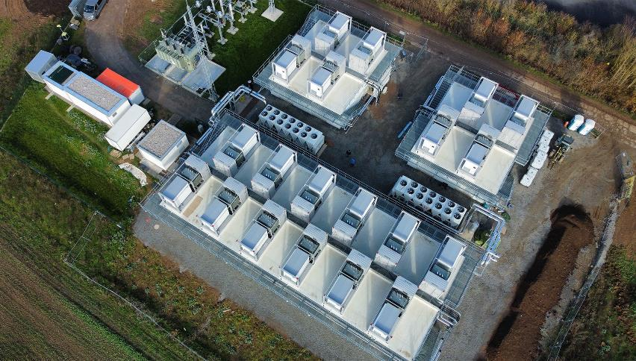
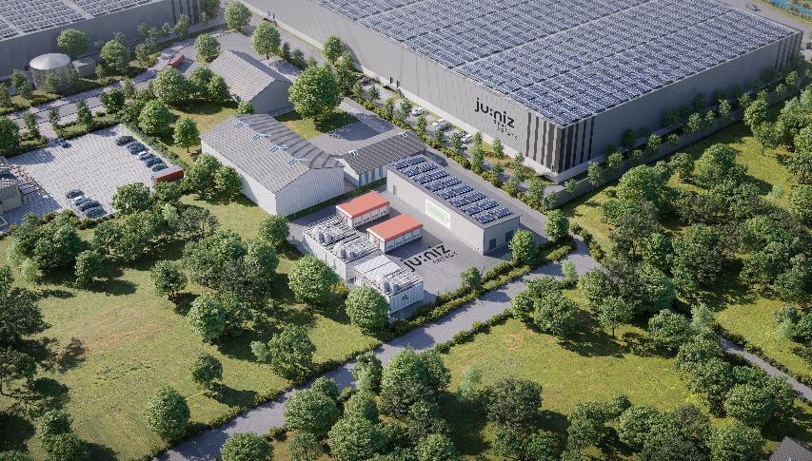



ju:niz Energy
Core business
Intelligent large-scale storage systems that are operated in a grid-serving and economical manner.
Decentral energy supply of renewable energies, battery storage and hydrogen for district areas
intelligent energy management systems that control both the battery storage systems and the decentral energy system for optimal use.
Founded
2014
Employees2023
66
Installed Capacity
145 MWh

Slide 6




Our projects within Germany
In Betrieb
Im Bau
Juwi 1 Schmölln | 2,9 MW/ 3 MWh
Siemens Fluence Wölkisch | 4,8 MW/ 5,2 MWh
Frankfurt Energy Großenh. | 1,5 MW/ 1,6 MWh
SMAREG 9 Freiberg |24 MW/ 24 MWh
SMAREG 3 Eisfeld | 12 MW/ 12 MWh
SMAREG 4 Wartburgspeicher Eisenach | 60 MW/ 67 MWh
SMAREG 5 Hildburghausen | 12 MW/ 13,6 MWh
Speicher Petersaurach | 1,1 MW/ 1,4 MWh
Speicher Freyung | 0,6 MW/ 1,2 MWh
SP Garching | 1,4 MW/ 1,2 MWh
Greenrock Trostberg | 1,2 MW/ 1,5 MWh
SMAREG 8 Calbe | 24 MW/ 24 MWh
Speicher Echte | 1,1 MW/ 1,4 MWh
SMAREG 2 Breitenworbis | 10 MW/ 11 MWh
Smartbooster Gotha | 11 MW/ 11 MWh
Speicher Heuchelheim | 4,2 MW/ 4,2 MWh
Speicher Leinburg | 1,0 MW/ 1,4 MWh
Juwi 2 Seckach | 3,6 MW/ 3,7 MWh
SMAREG 6 Gunzenhausen | 24 MW/ 24 MWh
SMAREG 7 Monheim | 12 MW/ 12 MWh
LEW Rain am Lech | 1,5 MW/ 1,6 MWh
BayWa München | 0,2 MW/ 0,2 MWh
Speicher Kempten | 16,0 MW/ 8,5 MWh
SMAREG Energieversorger Leinau | 8,7 MW/ 3,7 MWh
Fuchstal | 5,8 MW/ 3,4 MWh

Slide 7

Showcase of Generation 1.0 BESS
02

Slide 8

Introduction to Generation 1.0 BESS
Generation 1.0 BESS
  25 Energy Storage plants across Germany
    Starting capacity 150kwh
    Average 1MWh capacity
    Up to 11MWh capacity
  Using mainly Samsung NMC Batteries
  and “Second Life” Batteries with LMO
Main Usage cases:
  Primary Frequency Control (Main Usage scenario)
  Peak Shaving
  Self-Supply for Electric Energy
  Reduction of Distribution Grid Fees

Slide 9








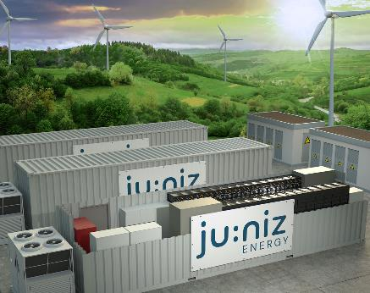
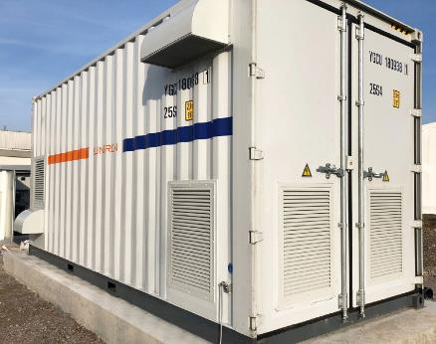
Large-scale storage increases flexibility in the energy supply for industry/commerce and in the electricity grid
Frequency reserve and trading
Peak Shaving, Optimisation of own comsumption, 7000h for industry and district areas
> 10 MWh
< 5 MWh
iEMS
Operational Services

Slide 10
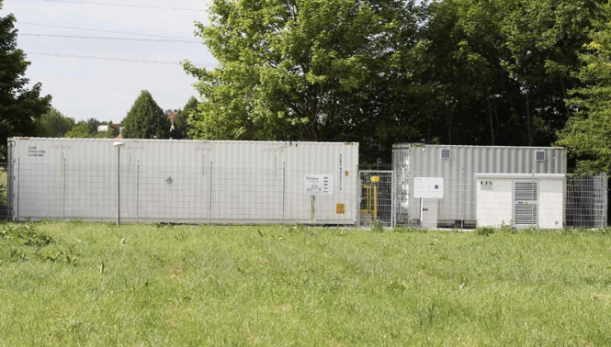

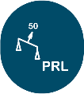



PRL-Speicher Garching near by Munich
Key Facts
Customer | Forschungsprojekt
Location | Campus der Technischen Universität München
Completion | 2016
Power | 1,4 MW
Capacity | 1,2 MWh
System | Samsung SDI / Daimler
Design | 40 ft Battery container Rectifier Transformer
EMS | Smart Power iEMS
Technical Design

Slide 11

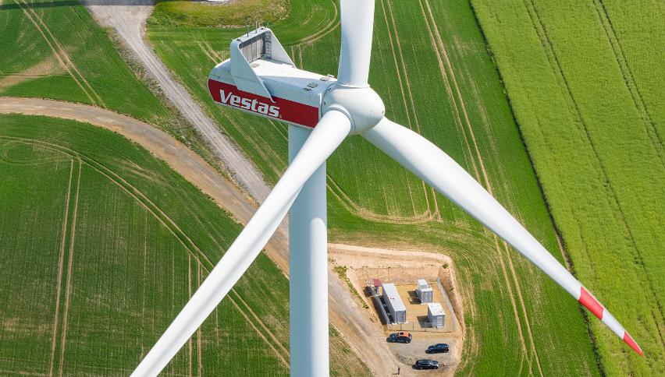


JUWI Schmölln - First German Innovation project “Wind Energy and Energy Storage”
Key facts
Customer | Juwi
Location | Schmölln
Completion | 2022
Power | 2,9 MW
Capacity | 3 MWh
System | SAMSUNG SDI
Design | 40 ft Battery container Rectifier
EMS | Smart Power iEMS
Technical Design

Slide 12
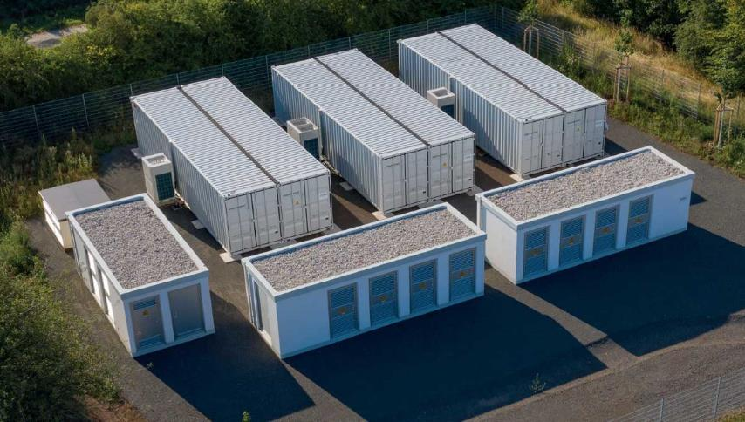
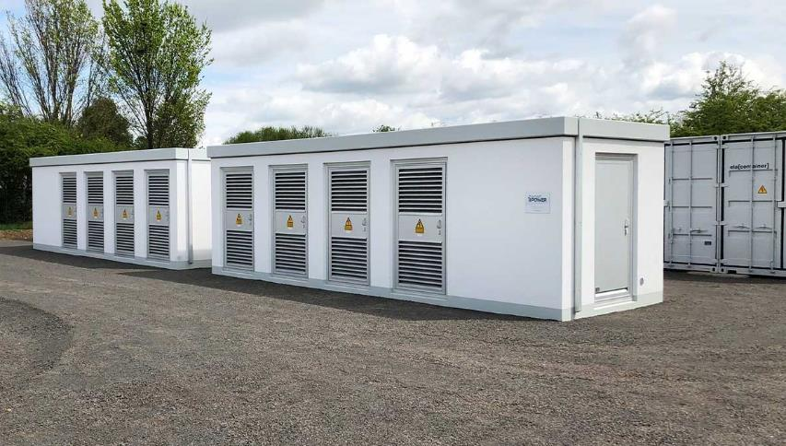

SMAREG 1 - Smartbooster
Key Facts
Customer | Investor project
Location | Gotha
Completion | 2020
Power | 11 MW
Capacity | 11 MWh
System | SAMSUNG SDI
Design | 40 ft Battery container Rectifier Transformer Transfer station
EMS | Smart Power iEMS
Technical Design

Slide 13
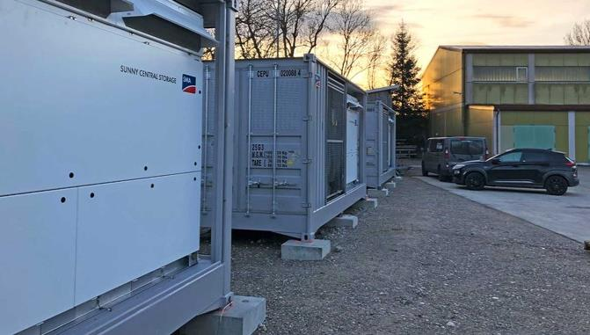
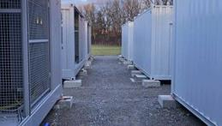

VWEW Leinau
Key Facts
Customer | Industrial Customer
Location | Kaufbeuren
Completion | 2021
Power | 7,3 MW
Capacity | 3,7 MWh
System | SAMSUNG SDI
Design | 20ft Battery container Rectifier Transformer
EMS | Smart Power iEMS
Technical Design

Slide 14
Showcase of Generation 1.5 BESS
03

Slide 15

Introduction to Generation 1.5 BESS
Generation 1.5 BESS
  7 Energy Storage plants across Germany
    Starting capacity 11MWh
    Average 23.7MWh capacity
    Up to 67MWh capacity
    Sum of 187.6MWh
  Using mainly Samsung NMC Batteries
Main Usage cases:
  Primary Frequency Control
  (Main Usage scenario)
  Reduction of Distribution Grid Fees

Slide 16
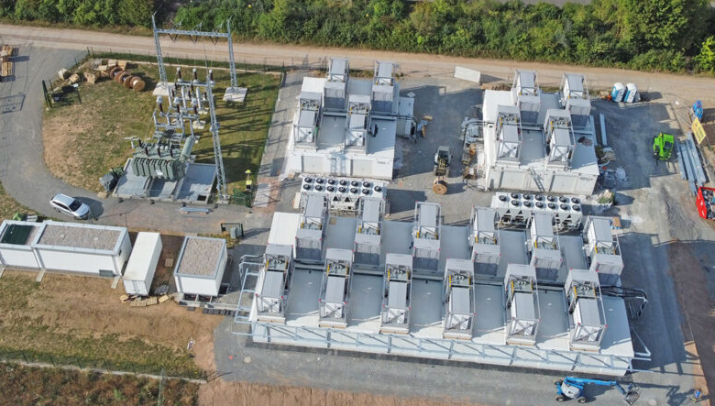
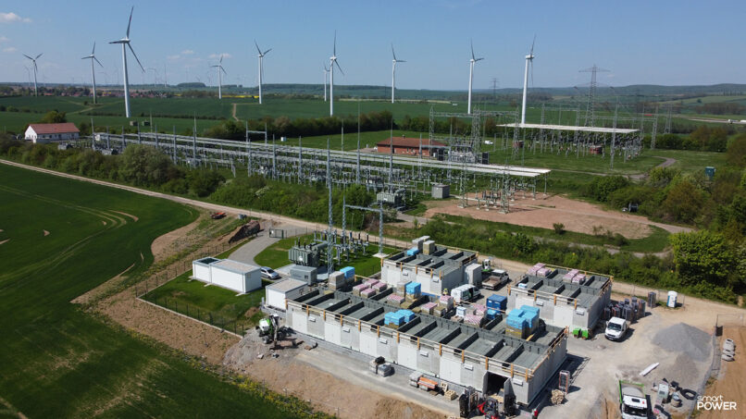
SMAREG4 – „Wartburgspeicher“
Key Facts
Customer | Investor project
Location | Eisenach
Completion | 2022
Power | 60 MW
Capacity | 60 MWh
System | SAMSUNG SDI
Design | 20x“Langhaus“ Design Rectifier Transformer
EMS | Smart Power iEMS
Technical Design

Slide 17
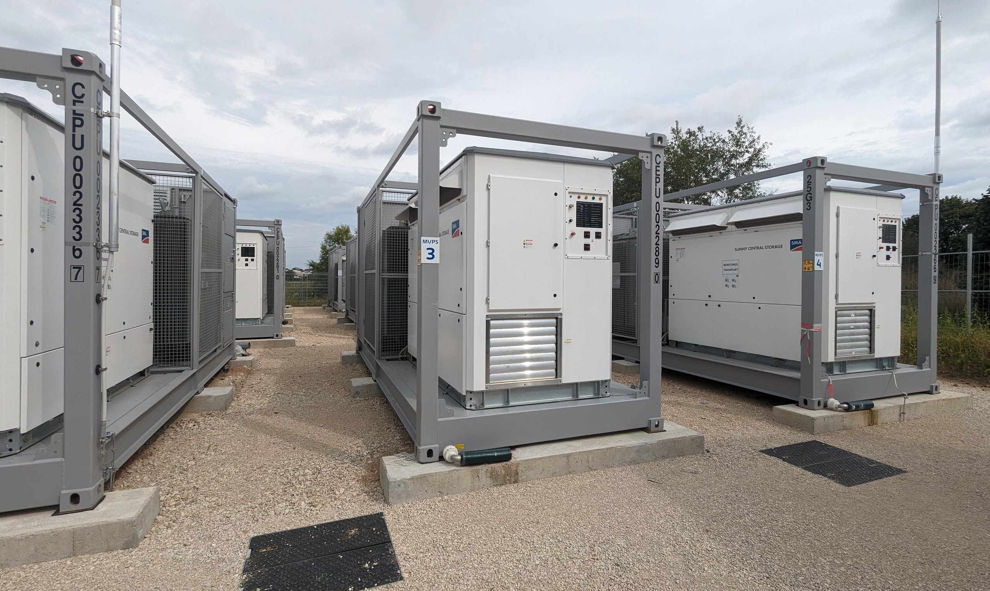
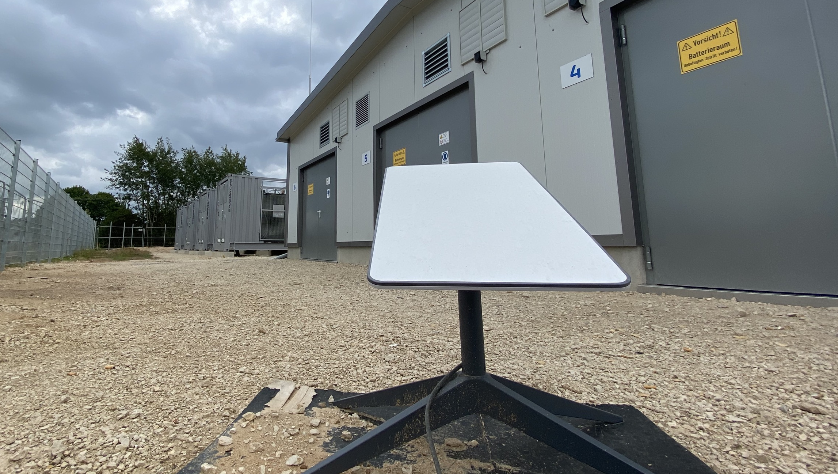
SMAREG6 – „Gunzenhausen“
Key Facts
Customer | Investor project
Location | Gunzenhausen
Completion | 2023
Power | 24 MW
Capacity | 24 MWh
System | SAMSUNG SDI
Design | 2x Tripple „Langhaus“ Design Rectifier Transformer
EMS | Smart Power iEMS
Technical Design

Slide 18
Agenda – Technical Portion
04
Overview – Historical Situation
The infrastructure which already existed
05
InfluxDB Cloud V1
Our journey to InfluxDB Cloud V1
06
InfluxDB Cloud Dedicated
Off to a shiny new cluster!
07
Gathering data with Telegraf from MQTT devices
How to harvest data from temporary sensor installations
08
Gathering data with Telegraf from Modbus devices
Gathering all information natively with Telegraf

Slide 19

Overview – Historical Setup
04

Slide 20
The Good Ol' Days
Centralised Monitoring Server:
  Rented vServer as the main influxDB Cluster
  No working backup solution
  Limitation of resources
  No upgrade of hardware/performance possible (dead end)
  Ubuntu Server installations close to end of life
Limitations of the legacy solution
  Unreliable syncing of data between Edge locations and centralised monitoring
  Due to Storage concerns, usage of retention policies to throw data out
  Due to throwing out data, analysis of the data is based on less precise information

Slide 21
Limitations of the used InfluxDB OSS 1.x
Features which were introduced with later influxDB OSS Versions
  Edge Data Replication: reliable way to sync data from Edge locations
  Flux Language: More flexible and powerful queries
  Integrated UI: Built-in dashboarding and alert management
  Tasks: Automated data processing without Kapacitor
  Token-based Auth: Enhanced security and access control
  Export/Import: Easier backup and restore options

Slide 22
InfluxDB Cloud V1
05

Slide 23
InfluxDB Cloud V1 – The begin of the journey
Requirements
  More reliable server setup (simple failover functionality at least!)
  Implementation of snapshots and backups
  Prevention to delete data due to storage issues
  Getting a more reliable data sync into the cloud
  Migrate all existing data from self-hosted influxDB instances into Cloud instance
Solution
  InfluxDB Cloud V1 Cluster – multiple node setup
  Implementation of Kapacitor Tasks to send data through Kapacitor to the influxDB Cloud
  Getting rid of storage issues or concerns

Slide 24
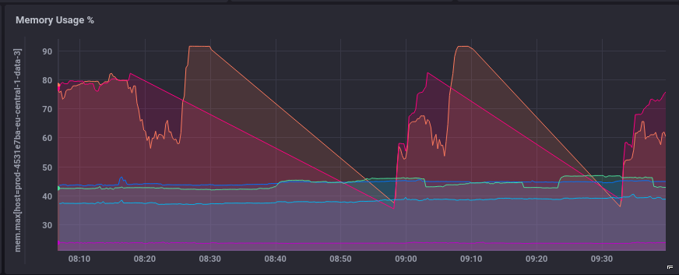
The problems and bottlenecks
Data Migration Headaches
  Due to the nature of our legacy infrastructure, using the influxDB OSS 2.x tools was not an option
  Importing the compressed line protocol exports took forever and failed a lot of times
Getting data into the Cloud
  Kapacitor tasks are running like
  a cronjob – no “real time” data ingests
  Kapacitor is not sending data multiple times
  if it failed the first time
Cluster load always spikes
  Cluster is having a hard time to keep up
  with the workload
  Even though not all legacy plants
  are ingesting data

Slide 25
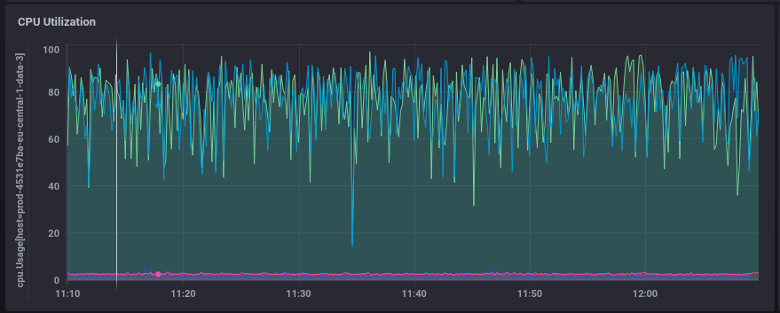
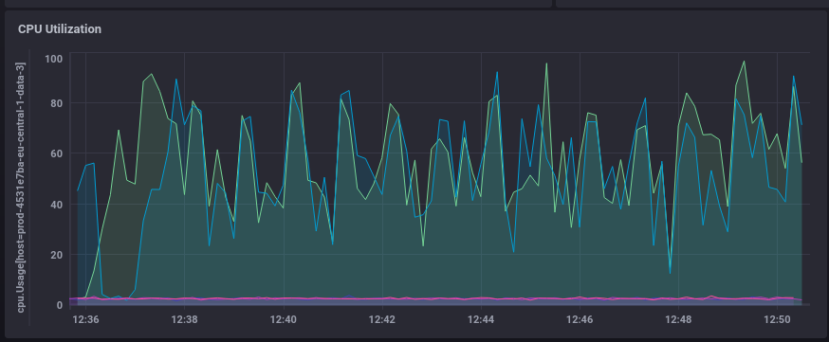
The problems and bottlenecks

Slide 26

InfluxDB Cloud Dedicated
06

Slide 27
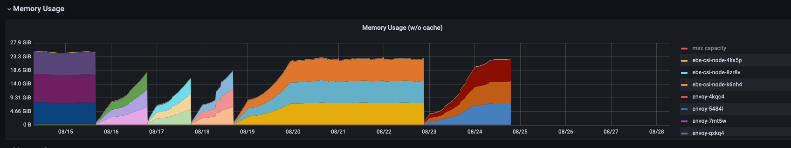
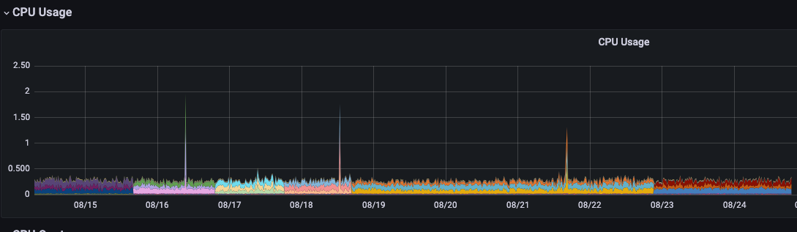
The problems and bottlenecks
Data Migration Headaches
  Normalization of inconsistent data since InfluxDB V3
  doesn’t support different data types per field
  Getting rid of legacy “retention” policies since
  storage isn’t a concern anymore
Getting data into the Cloud
  Using influxDB V2 write commands to send
  databases directly
  Running “inconsistent” databases through
  Telegraf to normalize the data
  Implementation of EDR for legacy plants
Cluster load
  Cluster is not having a hard time to keep up
  with the workload anymore
  All legacy plants are ingesting data now

Slide 28
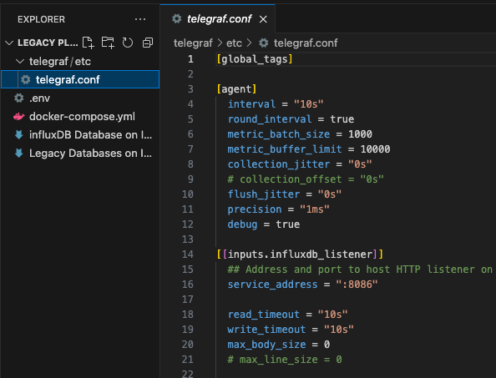
Introduction of EDR to Gen 1.0 Plants
Requirements
  More reliable transport from edge device data into cloud
  Avoiding to touch the actual plant control units, since
  touching the legacy scripts or SPS controls directly has a high risk
  potential of downtimes and interruptions
  Continuously data sending rather than getting data every 10mins
  Reliable mechanism to send back failed data
Solution
  Docker Compose “Swiss Army Knife” Container Setup
  which allows parallel installation to current local influxDB OSS
  Telegraf plays an influxDB v1 Listener
  Transfers data into influxDB OSS 2.4 Container
  Using EDR from the new influxDB Database
  Allows to keep all legacy scripts in place and no need to touch SPS
  Old Monitoring Server still gets data until all customers are migrated
  to the new Grafana instance

Slide 29
Gathering data with Telegraf from MQTT devices
07

Slide 30
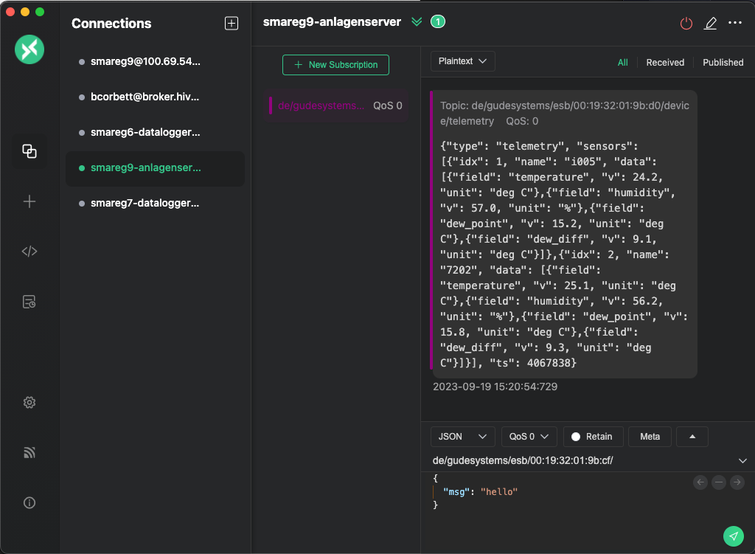
Temporary temperature logging
Requirements
  During construction time, final climate incl. all sensors
  are not yet working
  We need to have logging information about the
  temperatures and humidity for batteries
  Due to this being just temporary, the systems need to be
  implemented quickly with low costs
Solution
  LAN Temperature Sensors which report data via MQTT
  Gathering the data from MQTT with Telegraf
  Sending the Telegraf data to local influxDB OSS
  Using EDR to send to InfluxDB Cloud Dedicated V3
  Add the database in Grafana for visualization and alerts

Slide 31
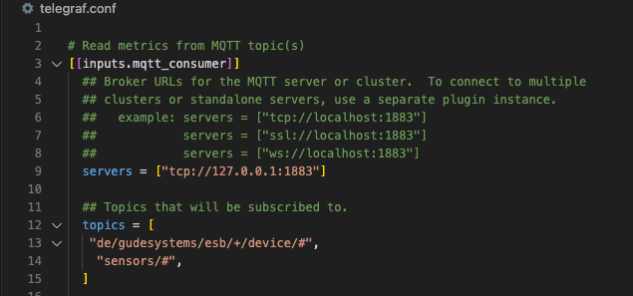
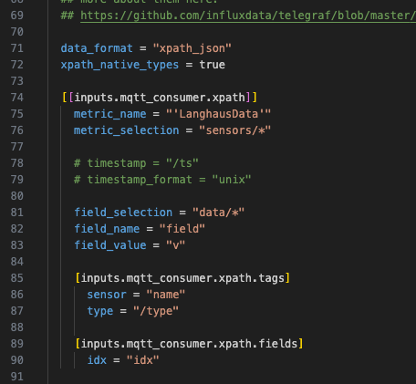
Telegraf.conf file for getting the job done
Telegraf Setup
  Define MQTT Consumer Input Plugin
  Define InfluxDB V2 Output Plugin
  Configure MQTT input plugin
MQTT Input Plugin
  Set processing data format, i.e. ”xpath_json”
  Define the Metrics name and selection
  Define your field names and values

Slide 32
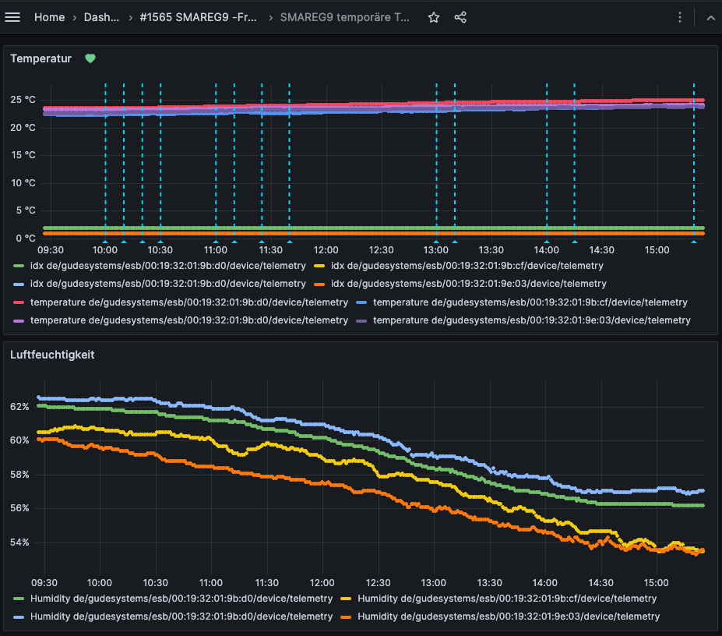
Grafana Visualization of temporary temperature logging
Grafana Visualization
  Showing information about each device and sensor
  Adding the information to Dashboards
  Allows historical information checking
Grafana Alerts
  Since plants in construction phase, are not actively in
  monitoring like “production plants” the alerts are important
  to notify about temperature/humidity issues
Notes:
Dashboard Link: https://grafana.juniz.energy/d/df2cf4a0-a527-45ab-b0ef-1dd670f7f95a/smareg9-temporare-temperaturueberwachung-baustelle?orgId=1

Slide 33

Gathering data with Telegraf from Modbus devices
08

Slide 34
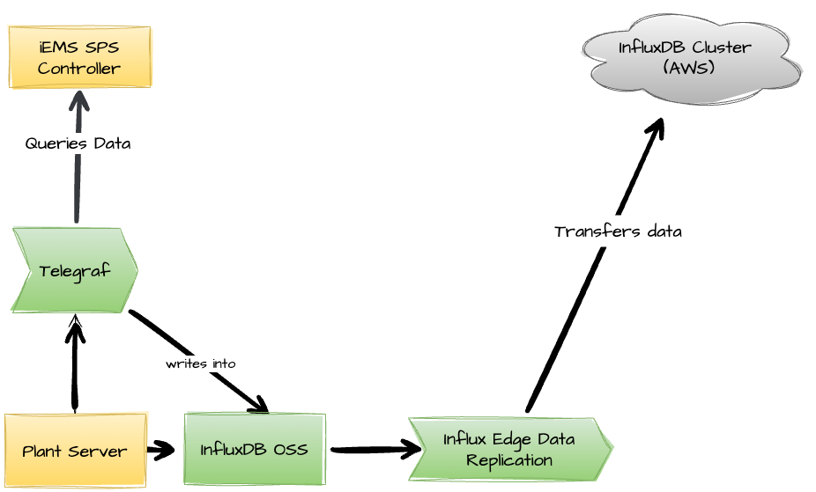
Architecture Overview
Local Plant setup
  Each plant has local servers running
  influxDB OSS infrastructure
  Implementation of Telegraf to read Modbus
  data from devices directly
  Telegraf ”no code” solution allows agile
  development and deployments
  InfluxDB EDR takes care of reliable sending
  of data to the cloud

Slide 35

InfluxDB Solution Partner – B1-Systems
About B1-Systems
  B1 Systems is a worldwide operating provider of Consulting,
  Training, Managed Service & Support around Linux/Open Source with more
  than 150 employees
  Areas of expertise
  Container and Virtualization
  Public & Private Cloud
  High Availability Cluster
  Configuration & System Management
  Monitoring & Log Management
  Products
  Client, Display & Server Management
  Locations
  Rockolding
  Cologne
  Berlin
  Dresden
  Jena
Notes:
Dashboard Link: https://grafana.juniz.energy/d/df2cf4a0-a527-45ab-b0ef-1dd670f7f95a/smareg9-temporare-temperaturueberwachung-baustelle?orgId=1

Slide 36
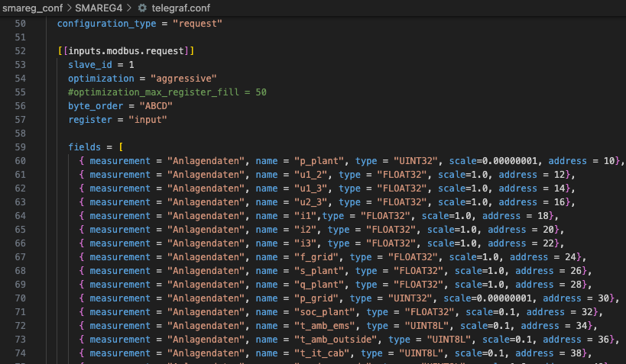
Telegraf.conf file for getting the job done
Telegraf Setup
  Define Modbus Input Plugins
  Define Modbus registers for each sector of the plant
  Configure InfluxDB Output Plugin
  Configure – depending on plant size – multiple telegraf.conf
  files to allow parallel data querying
  “No Code” solution without dependencies for
  modifications unlike SPS

Slide 37
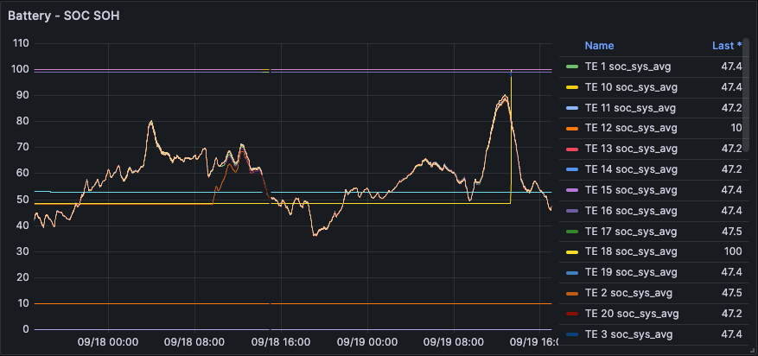
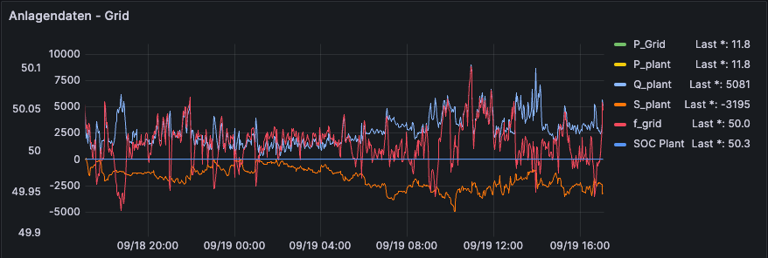
Grafana Visualization of BESS
Grafana Visualization
  Adding variables which allows flexible investigation of data
  No performance issues – if you check one battery or twenty
  Dashboards can be used for automated reporting
  Standardized dashboards allow quicker deployments and
  connecting new projects into the monitoring
Notes:
Dashboard Link: https://grafana.juniz.energy/d/df2cf4a0-a527-45ab-b0ef-1dd670f7f95a/smareg9-temporare-temperaturueberwachung-baustelle?orgId=1

Slide 38
Improving the Alert mechanism for both Generation BESS Systems
Grafana Multi-Dimensional Alerts
  Allows complex alert conditions based on multiple metrics
  Supports time-based conditions (e.g., alert if SOC < 20 for 15 mins)
  Provides greater context, reducing false positives
Sending Grafana Alerts Through Opsgenie
  Direct Integration of Grafana Alerts with Jira Ticket System
  Allows on-call scheduling and routing rules
  Allows additional notification in case of emergency, i.e. via SMS and phone call
  Creating Jira Tickets via Opsgenie
  Auto-generate Jira tickets for specific alert conditions
  Streamlines incident management workflow
Notes:
Dashboard Link: https://grafana.juniz.energy/d/df2cf4a0-a527-45ab-b0ef-1dd670f7f95a/smareg9-temporare-temperaturueberwachung-baustelle?orgId=1

Slide 39
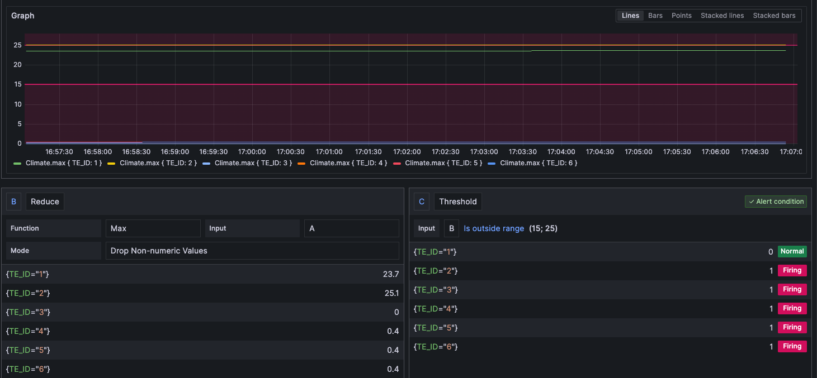
Grafana Alerts
Notes:
Dashboard Link: https://grafana.juniz.energy/d/df2cf4a0-a527-45ab-b0ef-1dd670f7f95a/smareg9-temporare-temperaturueberwachung-baustelle?orgId=1

Slide 40
Grafana Visualization of BESS
Grafana Visualization
  LIVE DEMONSTRATION – SWITCH TO BROWSER AND CONTINUE HERE LATER
Notes:
Dashboard Link: https://grafana.juniz.energy/d/df2cf4a0-a527-45ab-b0ef-1dd670f7f95a/smareg9-temporare-temperaturueberwachung-baustelle?orgId=1

Slide 41
Summary and next projects/steps
Getting Data with Telegraf
  Telegraf supports wide range of devices and communication protocols
  Allows easy integration – like influxDB Database – “no need to think about it twice”
  Supported and integrated in a wide range of products, i.e. our firewalls have a Telegraf plugin
InfluxDB Edge Data Replication
  Makes sending data stable even with unreliable network connections
  Reliable re-sending of failed metrics
  InfluxDB Cloud Dedicated
  (Nearly) no need to think about storage costs and usage anymore
  Way better compression compared to influxDB Cloud V1 or OSS
  Next projects and steps
  Evaluating communication between our SPS controllers and Telegraf with OPA-UA
  Evaluating communication between our SPS controllers and Telegraf with MQTT
  Integration of EPEX SPOT data
  Centralised cluster for analytics between batteries and market data
Notes:
Dashboard Link: https://grafana.juniz.energy/d/df2cf4a0-a527-45ab-b0ef-1dd670f7f95a/smareg9-temporare-temperaturueberwachung-baustelle?orgId=1

Slide 42

energy transition
Wanna shape the
Where you can
get
involved
We're hiring like crazy – not limited to IT jobs! Find out about your next big move at ju:niz. 🚀
We take responsibility for our actions, ask questions, even the uncomfortable ones, and courageously try out new approaches.
Interested in pushing our shiny new InfluxDB Cloud Cluster to the max? Let's sit down for a coffee and discuss your path to joining the ju:niz team.😁
www.juniz.com

